Slide 1
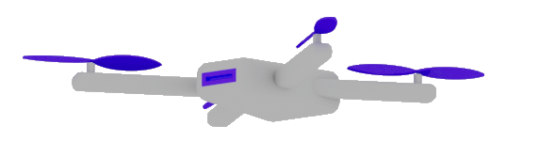

Architecting and Developing Custom Copilots and Agent
https://www.linkedin.com/in/damirdobric/
Dr. Damir Dobric
Lead Software Architect daenet GmbH / ACP Digital
Microsoft Regional Director,
Most Valuable Professional: AI

Slide 2

ML vs. GenAI What is different and why it is important?
Traditional ML
Lot of Data
Long Training
GenAI
Pretrained
GPT=General Pretrained Transformer

Slide 3
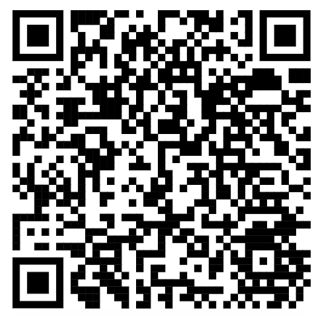
All Slides and Demos
https://github.com/ddobric/semantic-kernel-training
https://tinyurl.com/49tf9346

Slide 4
AI Services
Open AI
https://platform.openai.com/docs/models
Azure AI Foundry https://oai.azure.com/portal/****/models https://ai.azure.com/
Request Access to Azure OpenAI Service (microsoft.com)

Slide 5
TOKENS

Slide 6

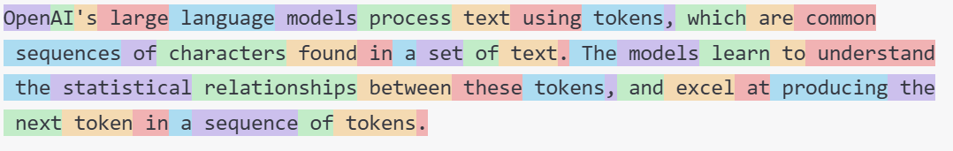
What are Tokens?
1 token ~= 4 chars in English
1 token ~= ¾ words
100 tokens ~= 75 words
Byte Pare Encoding (Gage,1994): Wikipedia
What are tokens and how to count them?
Token Pricing: Pricing (openai.com)

Slide 7
DEMO
Tokenizer
Creating tokens in C#

Slide 8
EMBEDDINGS

Slide 9
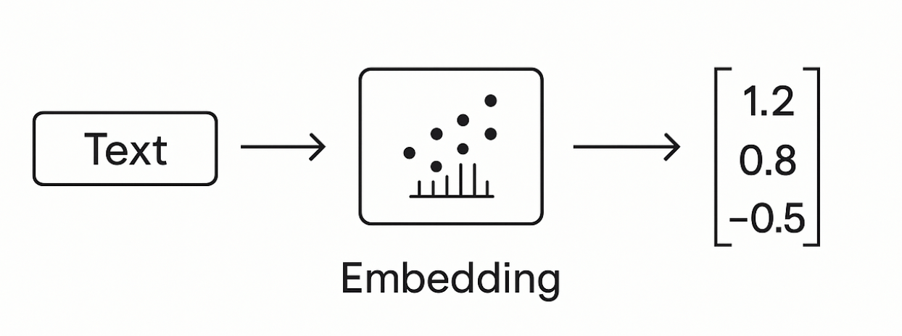
Embeddings
Making a vector from text

Slide 10
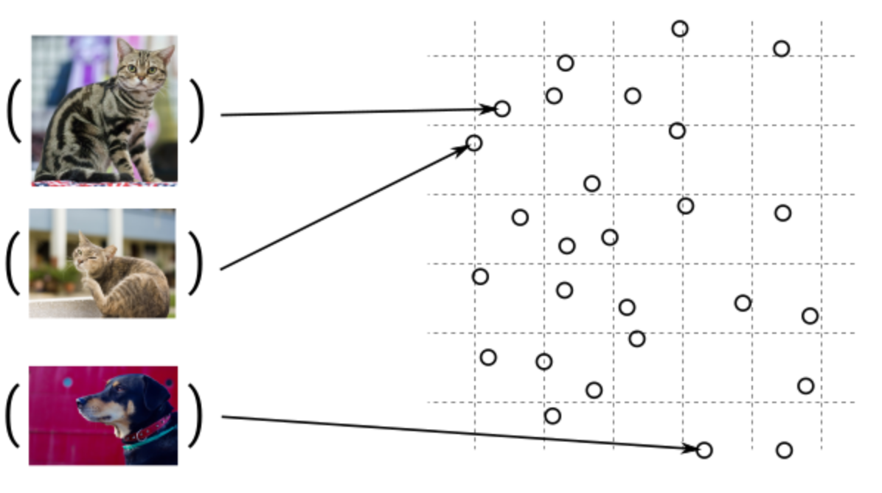
Guess, today is a nice day in Palma
Embedding Models
Today is a typical German rainy day
Two things are infinite: the universe and human stupidity; and I'm not sure about the universe.

Slide 11
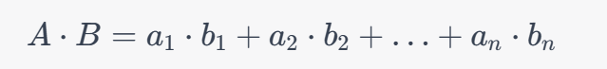
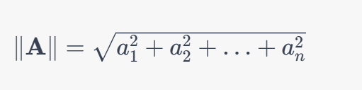
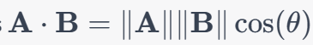
Similarity Between Multidimensional Vectors
Dot Product
The Norm
Cosine Similarity

Slide 12
When to use Embeddings?
Semantic Search
Classification
Clustering
Recommendations
. . .

Slide 13
DEMO
Consuming Embedding Model with HTTP/Post
Creating Embeddings in C#

Slide 14
VECTOR DATABASES

Slide 15
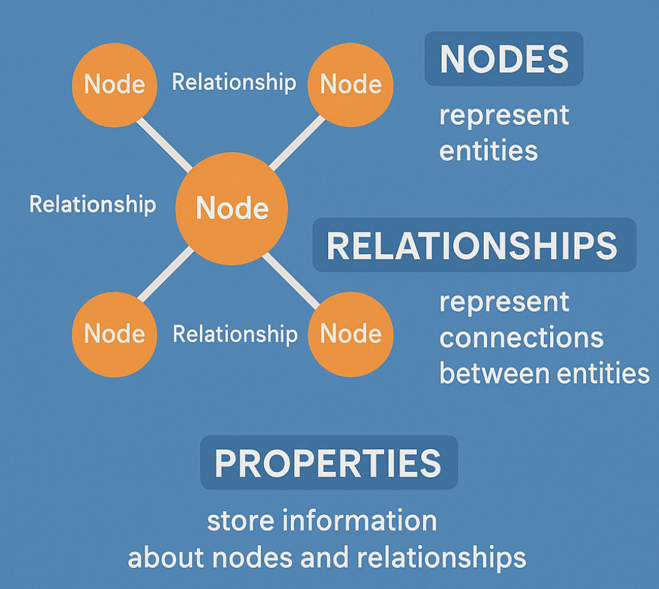
Graph Databases

Slide 16
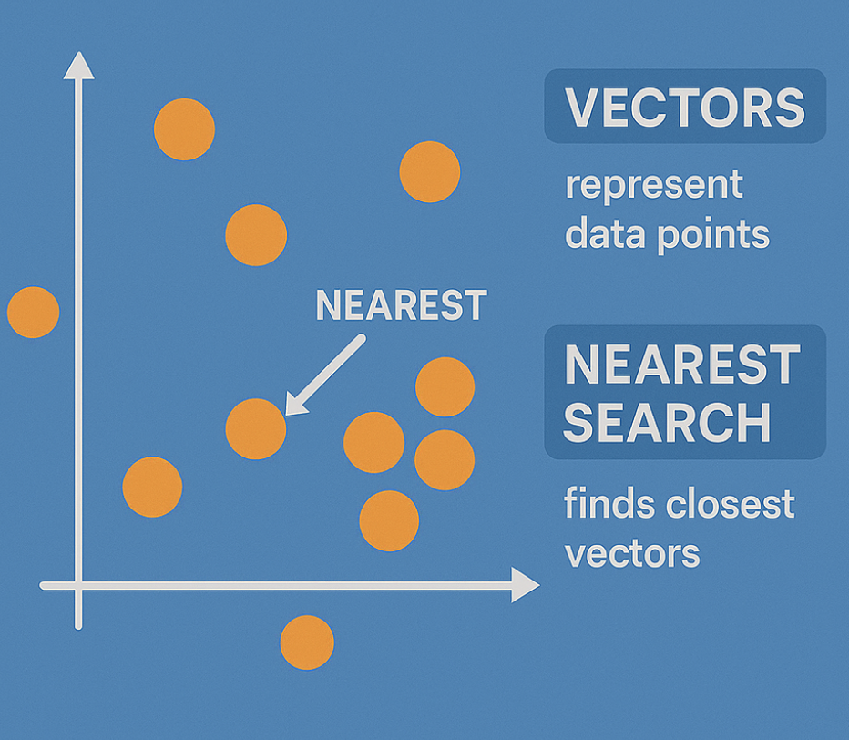
Embeddings in GraphDB

Slide 17
Vector DBs
SqlServer 2025 Native Vector Search
Quadrant
CosmosDB
…

Slide 18
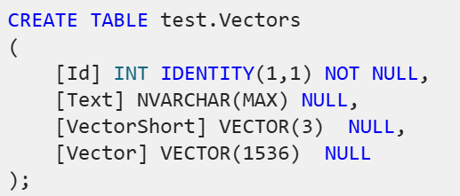
SqlServer 2025 Native Vector Search
SqlServer 2025 Native Vector Search
In Azure
On-Prem
SQL Server Native Vector Search for .NET Developers

Slide 19
The New Vector Type
SqlCommand command = new SqlCommand($"INSERT INTO [test].[{_cTableName}] ([Vector], [Text]) VALUES (@Vector, @Text)", connection);
command.Parameters.AddWithValue("@Vector", new SqlVector<float>(float[]{…}));

Slide 20

The New Vector Type as JSON ADO.NET Driver v<6.1.0
sqlCmd.Parameters.AddWithValue("@Vector", JsonSerializer.Serialize(new float[] { 1.12f, 2.22f, 3.33f }));
sqlCmd.Parameters.AddWithValue("@Vector", ‘[1.12, 2.22, 3.33]’);

Slide 21
DEMO
SQL Server Native Vector Search
SQL Server Native Vector
DECLARE @v1 VECTOR(2) = '[1,1]';
DECLARE @v2 VECTOR(2) = '[-1,-1]';
SELECT
VECTOR_DISTANCE('euclidean', @v1, @v2) AS euclidean,
VECTOR_DISTANCE('cosine', @v1, @v2) AS cosine,
VECTOR_DISTANCE('dot', @v1, @v2) AS negative_dot_product;

Slide 22
COMPLETION MODELS
How does all this work?

Slide 23
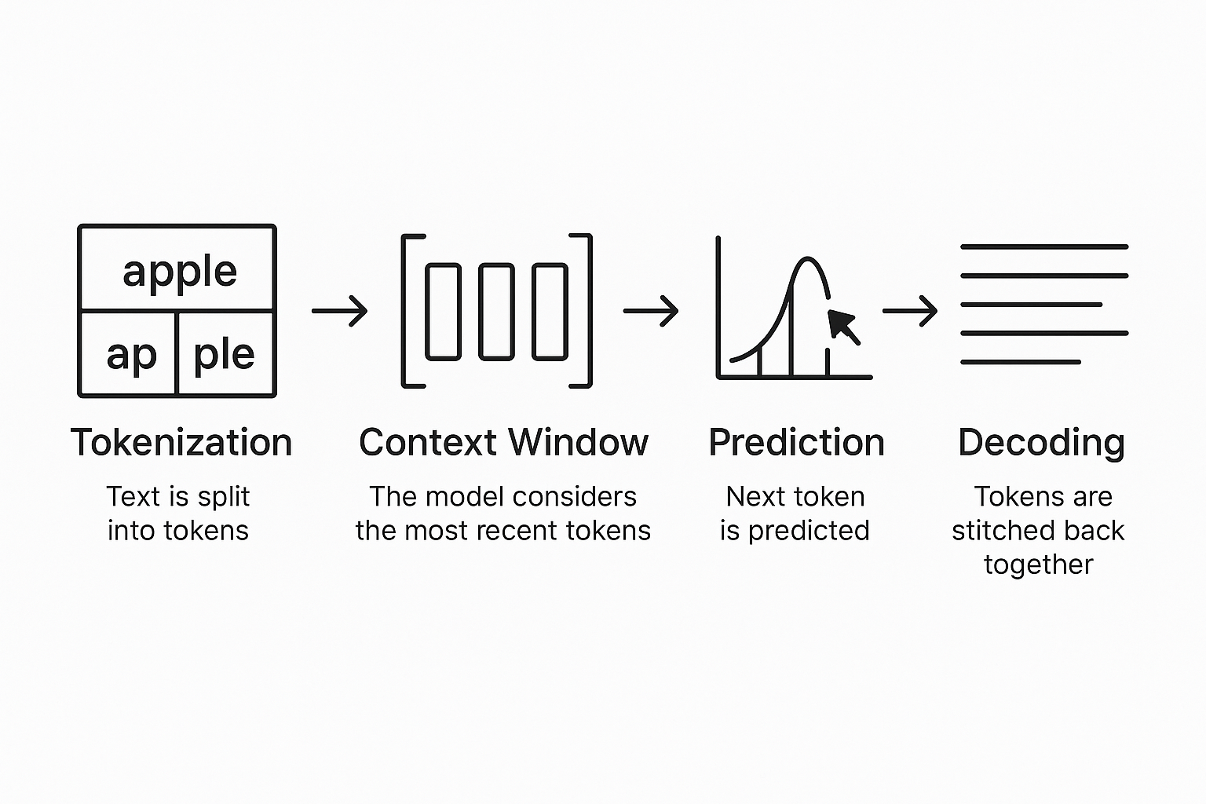
Completion Models
Text Completion Flow

Slide 24
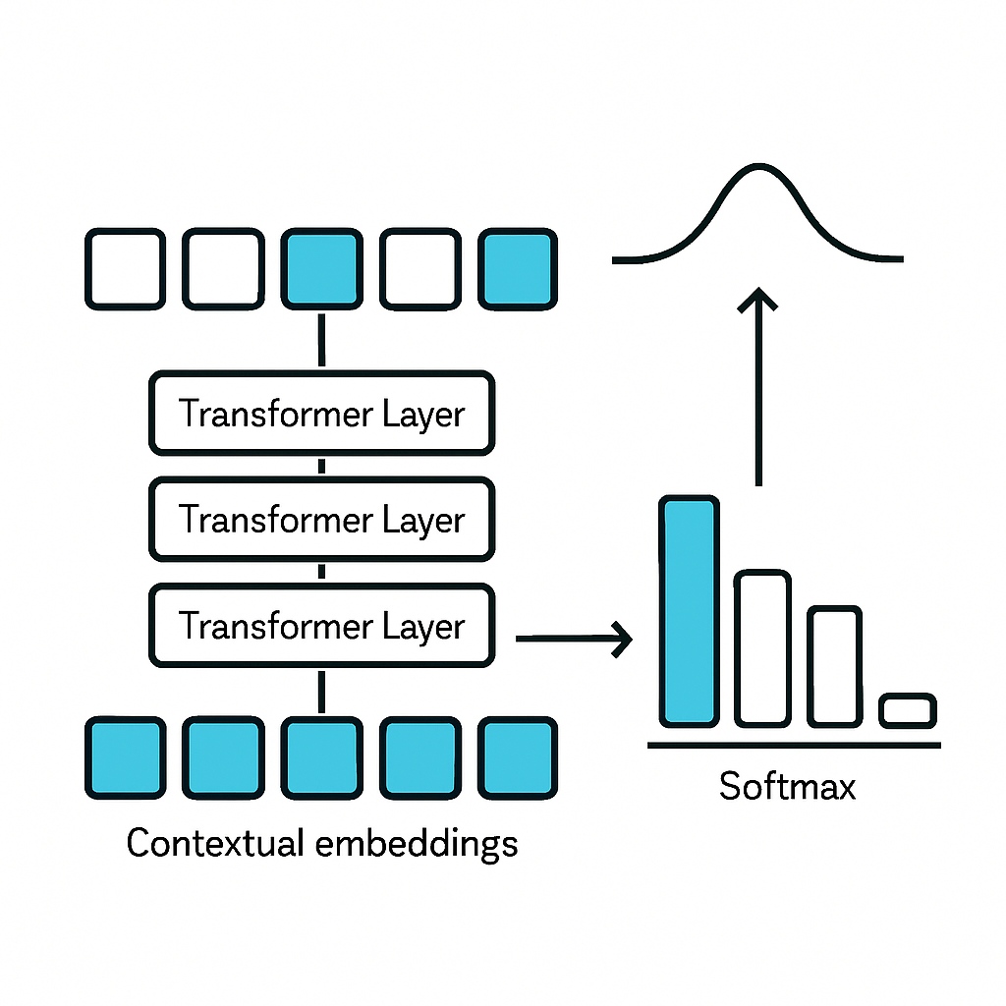
The algorithm
Transformers

Slide 25

DEMO
C# Application
Using OpenAI nuget package
Executing ChatCompletions
Presenting Probabilities

Slide 26
A Scientific look under the hub

Slide 27
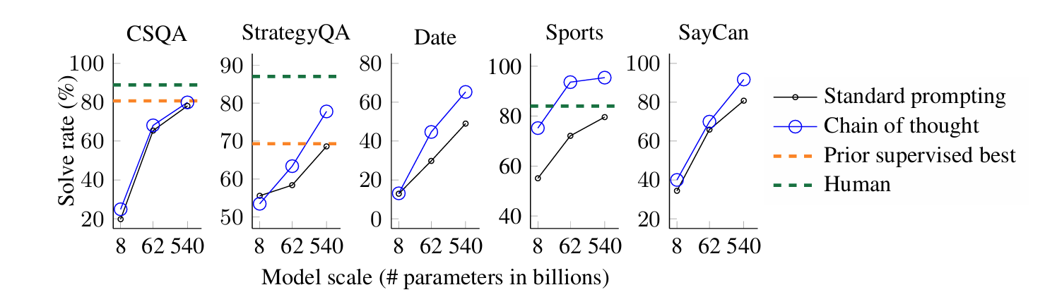
Chain of Tought
A prompting technique used to improve reasoning
Models think step by step before giving an answer.
Google Research, Brain Team
https://arxiv.org/abs/2201.11903

Slide 28
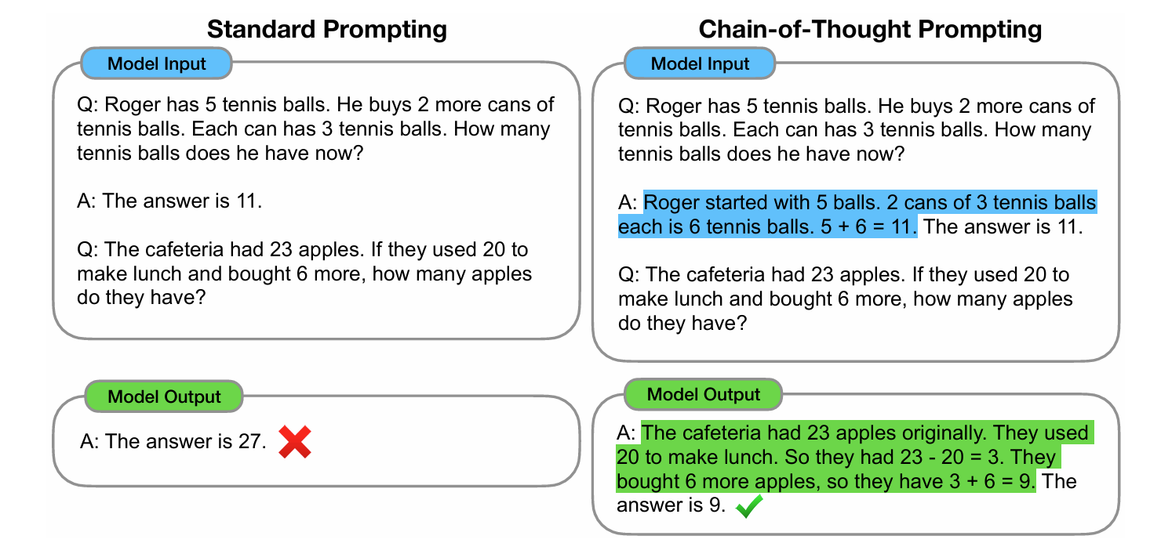
The Chain of Tought (CoT)

Slide 29
Reasoning
Common Models are
Outcome-Supervised Reward Models (ORM).
They use final answers
Reasoning Models
Receive Feedback on Each Step in Chain-of-Tought process
Process Reasoning Models (PRM)
https://cdn.openai.com/improving-mathematical-reasoning-with-process-supervision/Lets_Verify_Step_by_Step.pdf

Slide 30
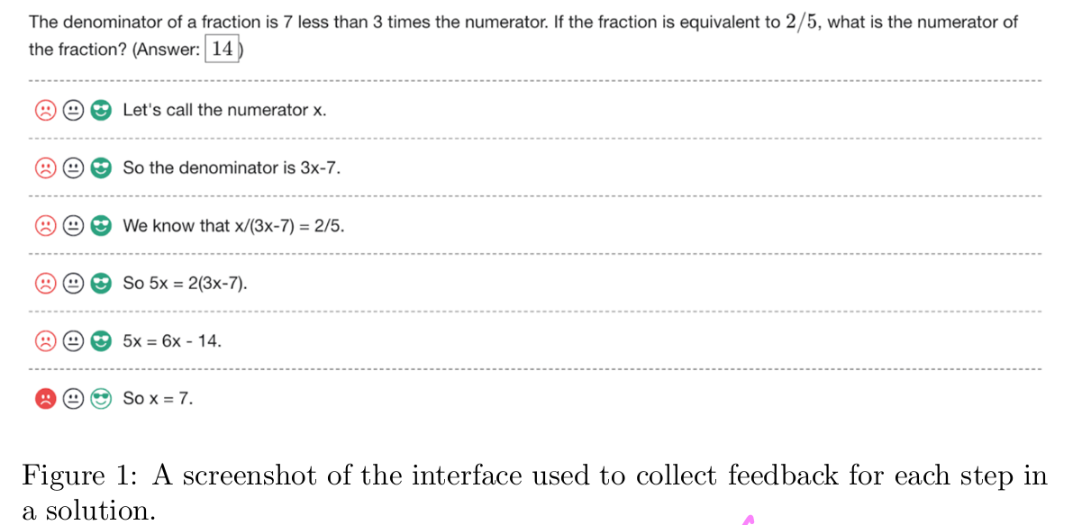
Human Supervised Learning

Slide 31
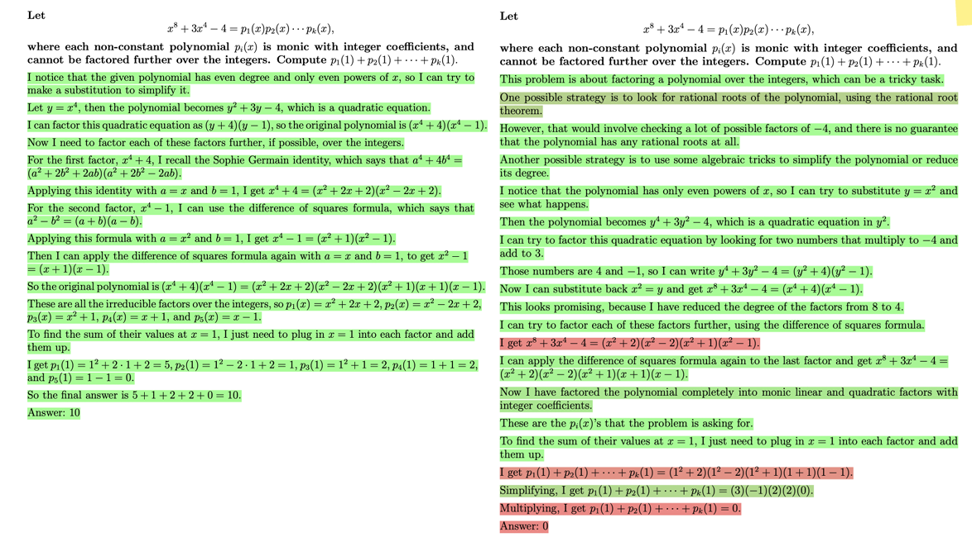

Slide 32
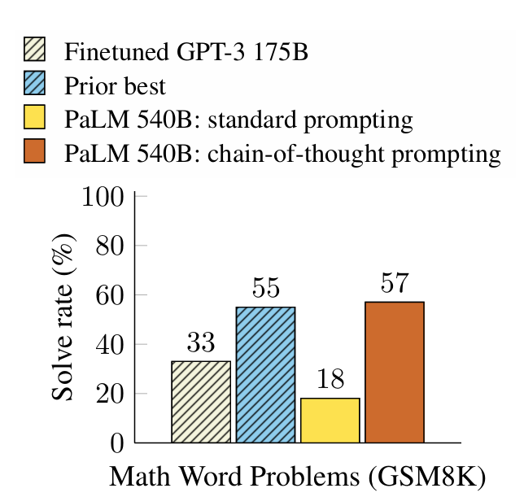
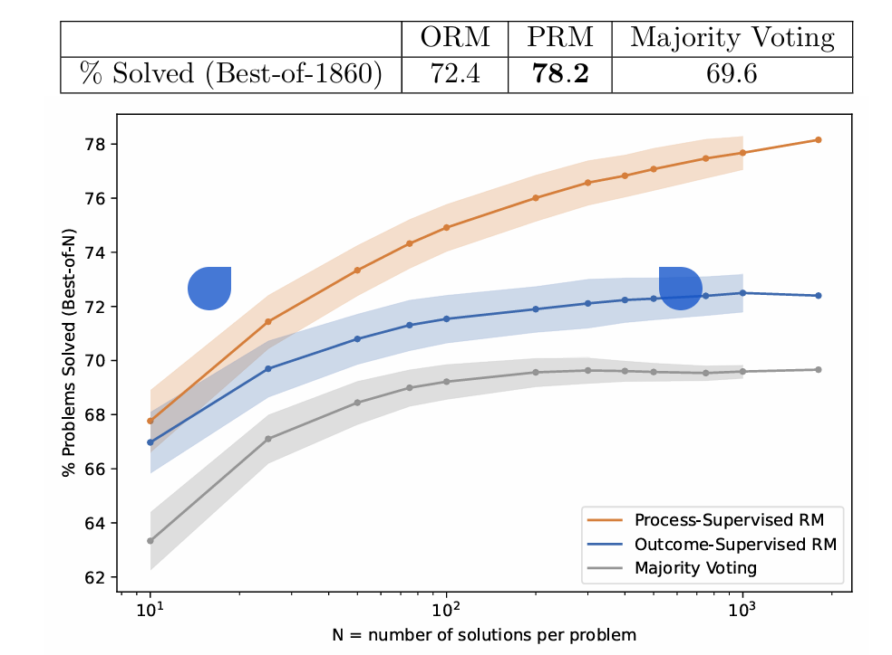
Comparison: CoT vs. PRM (Process Reasoning Models)
Hendrycks, C. Burns, S. Kadavath, A. Arora, S. Basart, E. Tang, D. Song, and J. Steinhardt. Measuring mathematical problem solving with the math dataset. arXiv preprint arXiv:2103.03874, 2021

Slide 33
Model Performance
LiveBench

Slide 34
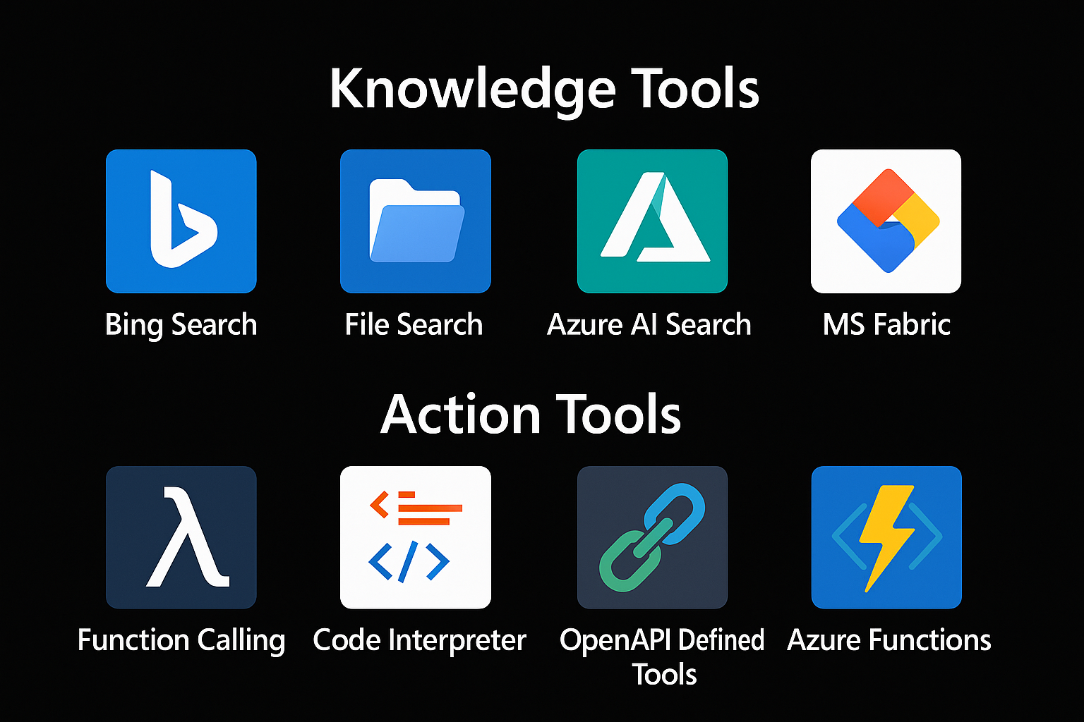

Extending Models
=> RAG
Tool 1
AGENT
=> Function Calling
Tool 2

Slide 35
RAG Retrieval Augmented Generation

Slide 36
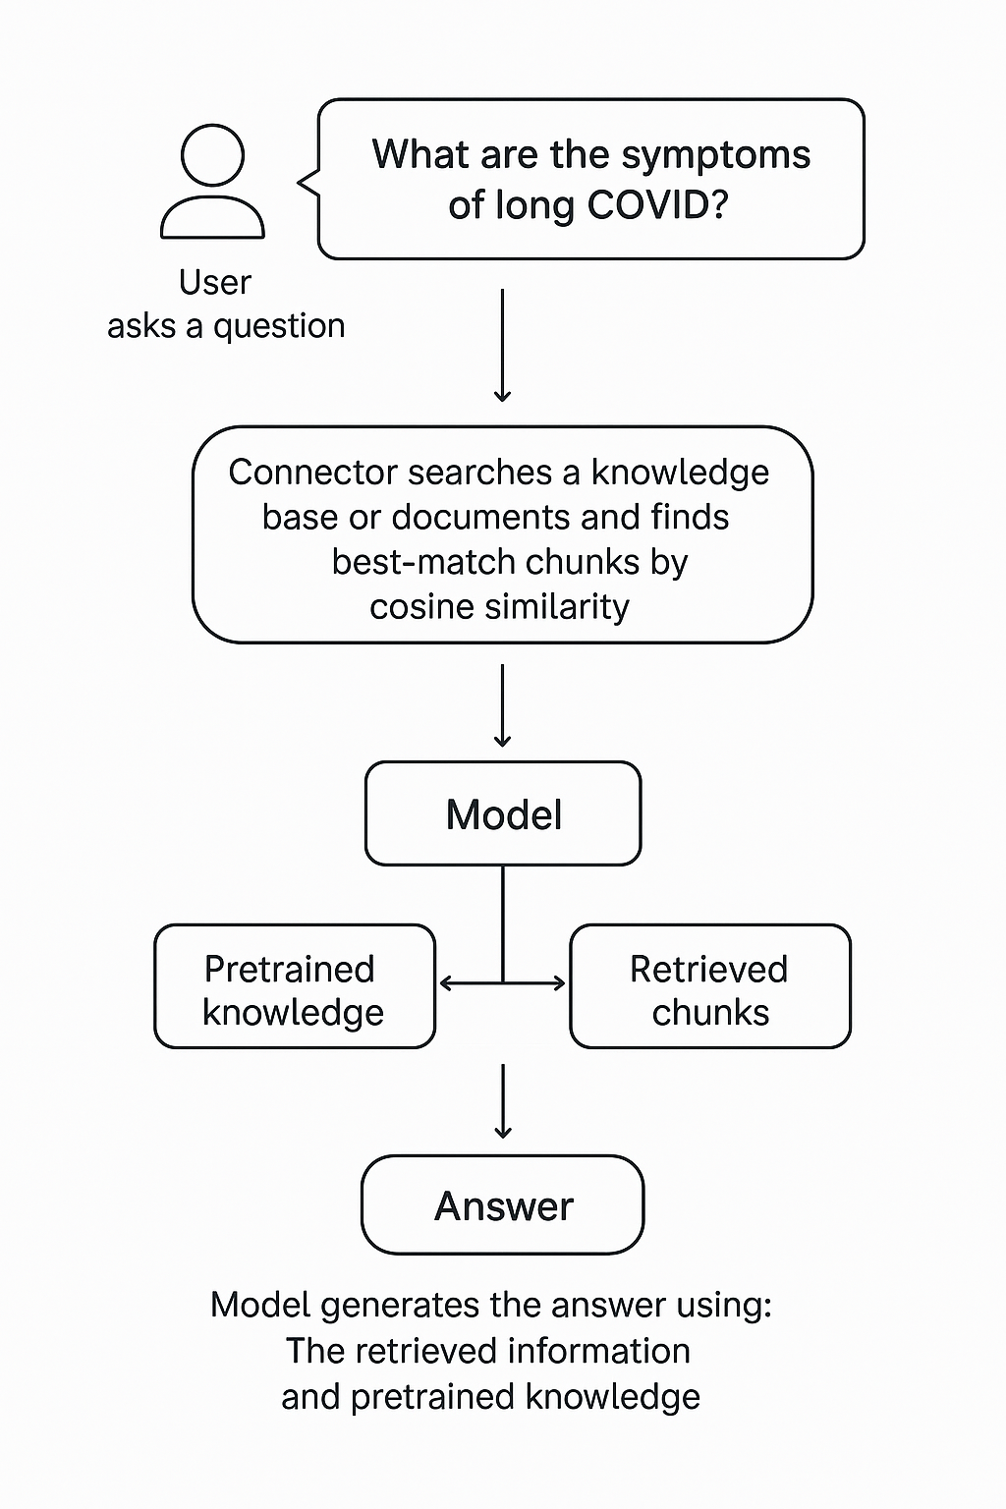
RAG Retrieval-Augmented Generation
Extending the model knowledge
Combines information retrieval with text generation
https://arxiv.org/abs/2005.11401

Slide 37
DEMO (c#)
Creating chunks
Creating embeddings
InMemory Vector DB
Calculating Similarity

Slide 38
Function Calling

Slide 39



Chat Model Interaction
User: How are you?
(1)
AI
Prompt
(2)
Assistent: I‘m fine, how can I help you

Slide 40

Function Calling
User: Switch on the light to green.
LichtPlugin
SwitchLightOn(color)
SwitychLightOff
(1)
WeatherPlugin
ShowInfo(Location)
AI
Prompt
(2)
My Database
Tool: SwitchLightOn(green)
Schritt 2:
KI ermittelt aus dem Prompt die passende Funktion und Argumente. Bsp.:
SchallteLichAn(grün)
Plugin Library
Enthält die Beschreibungen von Funktionen.

Slide 41
Function Calling
{
"type": "function",
"function": {
"name": "get_weather",
"description": "Retrieves current weather for the given location.",
"strict": true,
"parameters": {
"type": "object",
"properties": {
"location": {
"type": "string",
"description": "City and country e.g. Bogotá, Colombia"
},
"units": {
"type": ["string", "null"],
"enum": ["celsius", "fahrenheit"],
"description": "Units the temperature will be returned in."
}
},
"required": ["location", "units"],
"additionalProperties": false
}
}
}

Slide 42
MCP

Slide 43
Model Context Protocol Created by Anthropic Adopted by the AI community Evolving Together

Slide 44












Parts of MCP
Hosts
Clients
Servers
Notes:
There are 3 main parts to know about when talking about MCP
Hosts: programs like VS Code, Copilot Studio, IDEs, or AI tools that want to access data through MCP
Clients: Protocol clients, which sometimes are the same as the host, that maintain 1:1 connections with servers
Servers: Lightweight programs that each expose specific capabilities through the standardized Model Context Protocol. You can build your own servers or use on of the many servers that's already out there.
For example, you can connect directly to your database and analyze schemes, pull in information from GitHub repos such as issues and pull requests, automate end-to-end testing with Playwright, or you can even build your own servers with several SDKs including C#!

Slide 45
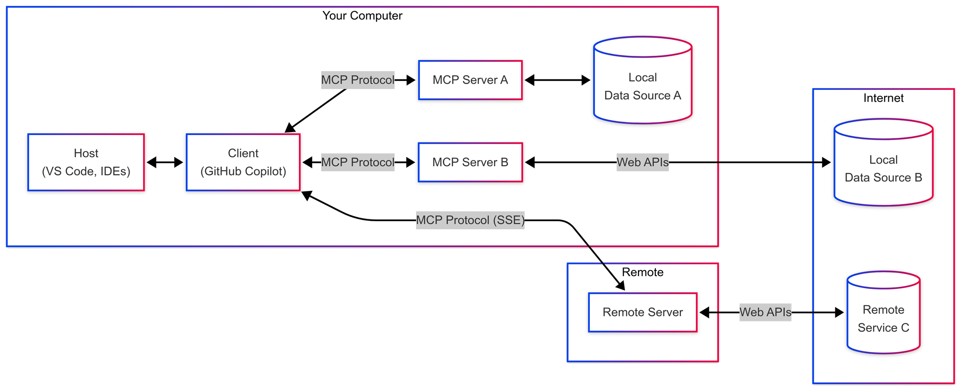



Slide 46
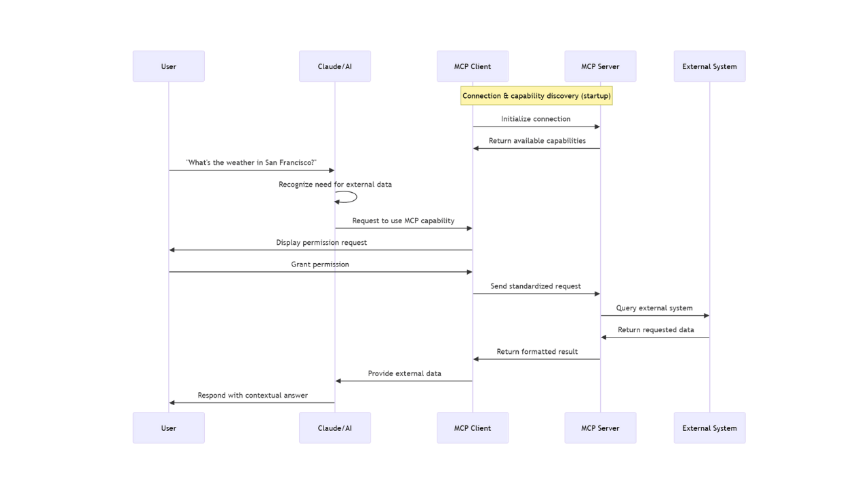
MCP – The Deep Dive

Slide 48
Semantic Kernel is an open-source SDK that lets you easily combine Generative AI Models syntactic programming languages like C#, Python an JAVA.
Currently supported languages: C#, Python
Currently supported AI Services: OpenAI, Azure OpenAI, and Hugging Face
Introduction | 🦜️🔗 Langchain

Slide 49
Why to use SK?
SK is a framework to build agents
You can easily use LLM models for chat, create images and video so on.
Making automated Agents that automate business processes is hard?
You need a framework for such complex engineering tasks.

Slide 50
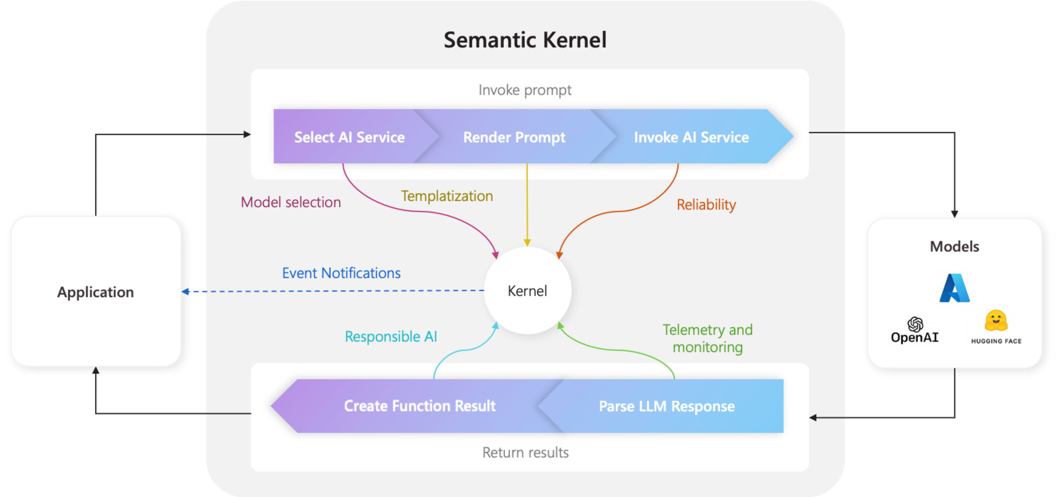
Architecture of the “Smart” application

Slide 51
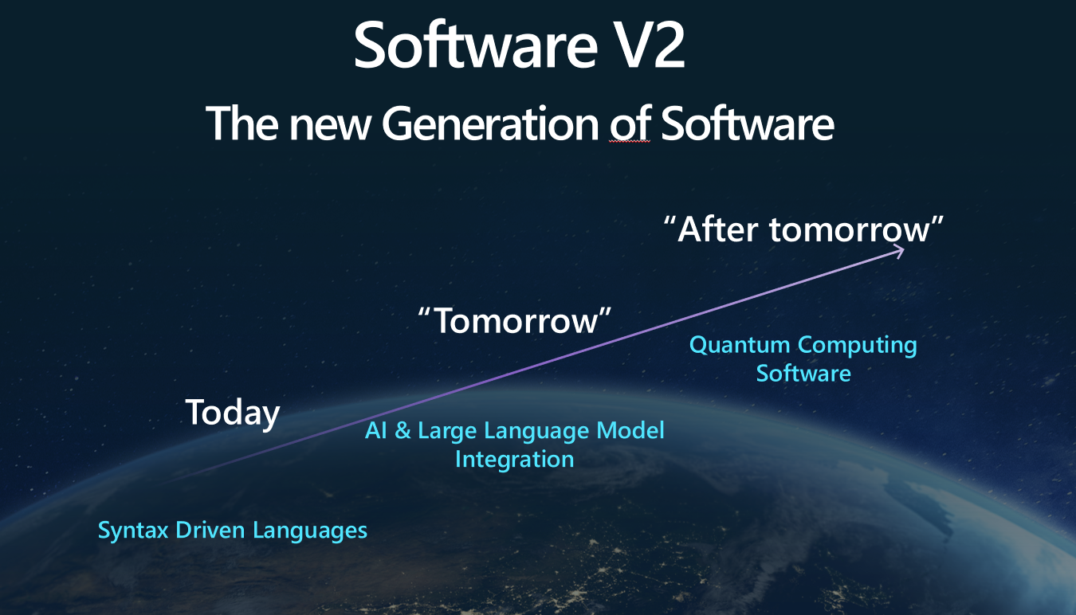
The Knowledge is inside Plugins
Native Functions (C#, Python, JAVA, ??)
Prompts (Semantic Functions)

Slide 52
DEMO
Controlling the lighting system

Slide 53
Two types of functions
Native Functions
Semantic Functions

Slide 54
NATIVE FUNCTIONS
[SKFunction, Description("Gets the UTC current time.")]
public string UtcNow()
{
return DateTime.UtcNow.ToString();
}
A native function is a function
defined by the code

Slide 55
PROMPTS (SEMANTIC FUNCTIONS)
Inline Functions
string prompt = @"Bot: How can I help you?
User: {{$input}}
---------------------------------------------
The intent of the user in 5 words or less: ";
A semantic function is a function
defined by the LLM prompt
Plugins
│
│─── Plugin1
│
│─── Function11
│─── Function12
└─── Plugin2
│
│─── Function21
│─── Function22
Add Ins
In-file Functions

Slide 56

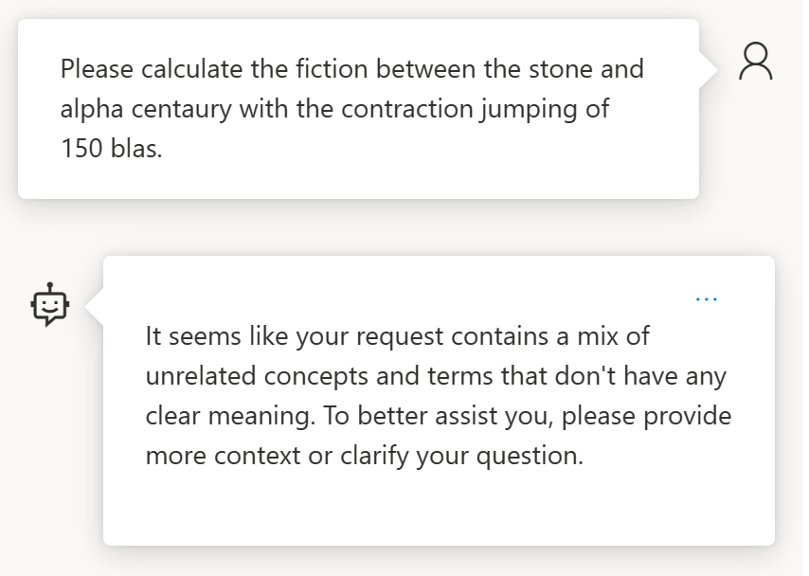
How about something not solvable?

Slide 57
AGENT FRAMEWORK

Slide 58
Demos
https://github.com/microsoft/agent-framework

Slide 59
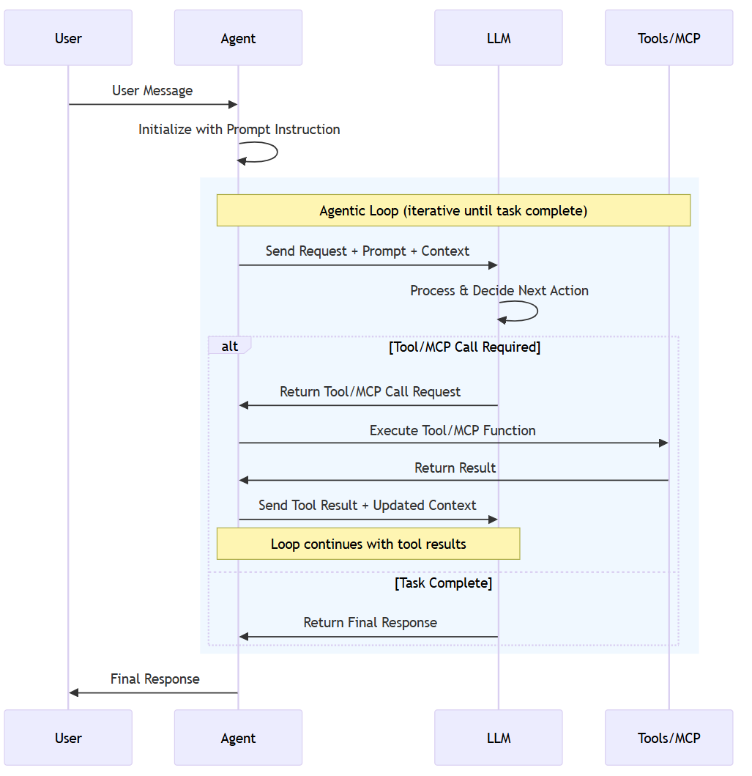

Slide 60


Orchestrating Workflows with Gen AI
Model
Task1
. . .
TaskN

Slide 61
DEMO - Microsoft AgentFramework Plugin with Tasks

Slide 62
PROCESS FRAMEWORK
semantic-kernel/dotnet/samples/GettingStartedWithProcesses
Process Framework | Microsoft Learn

Slide 63
Process Framework
Tool 1
AGENT
Tool 2
Tool N

Slide 65
Microsoft confidential
Pause: 10.30-11.00
https://github.com/ddobric/semantic-kernel-training/

